Slide 1

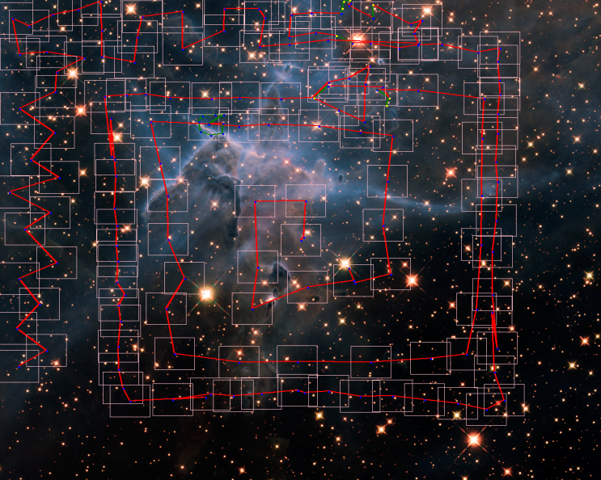
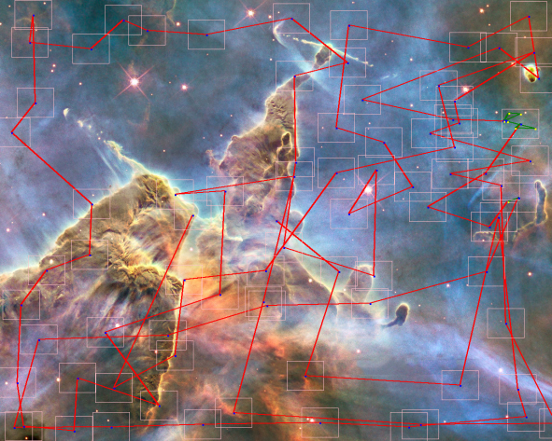
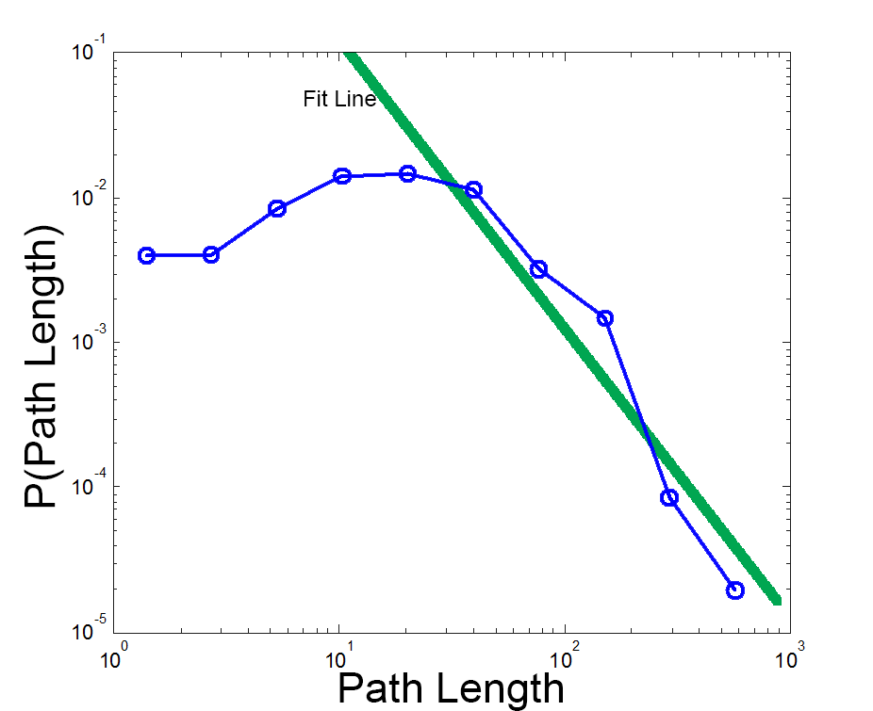
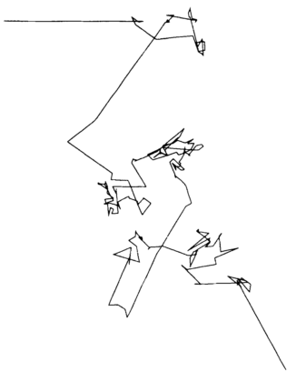
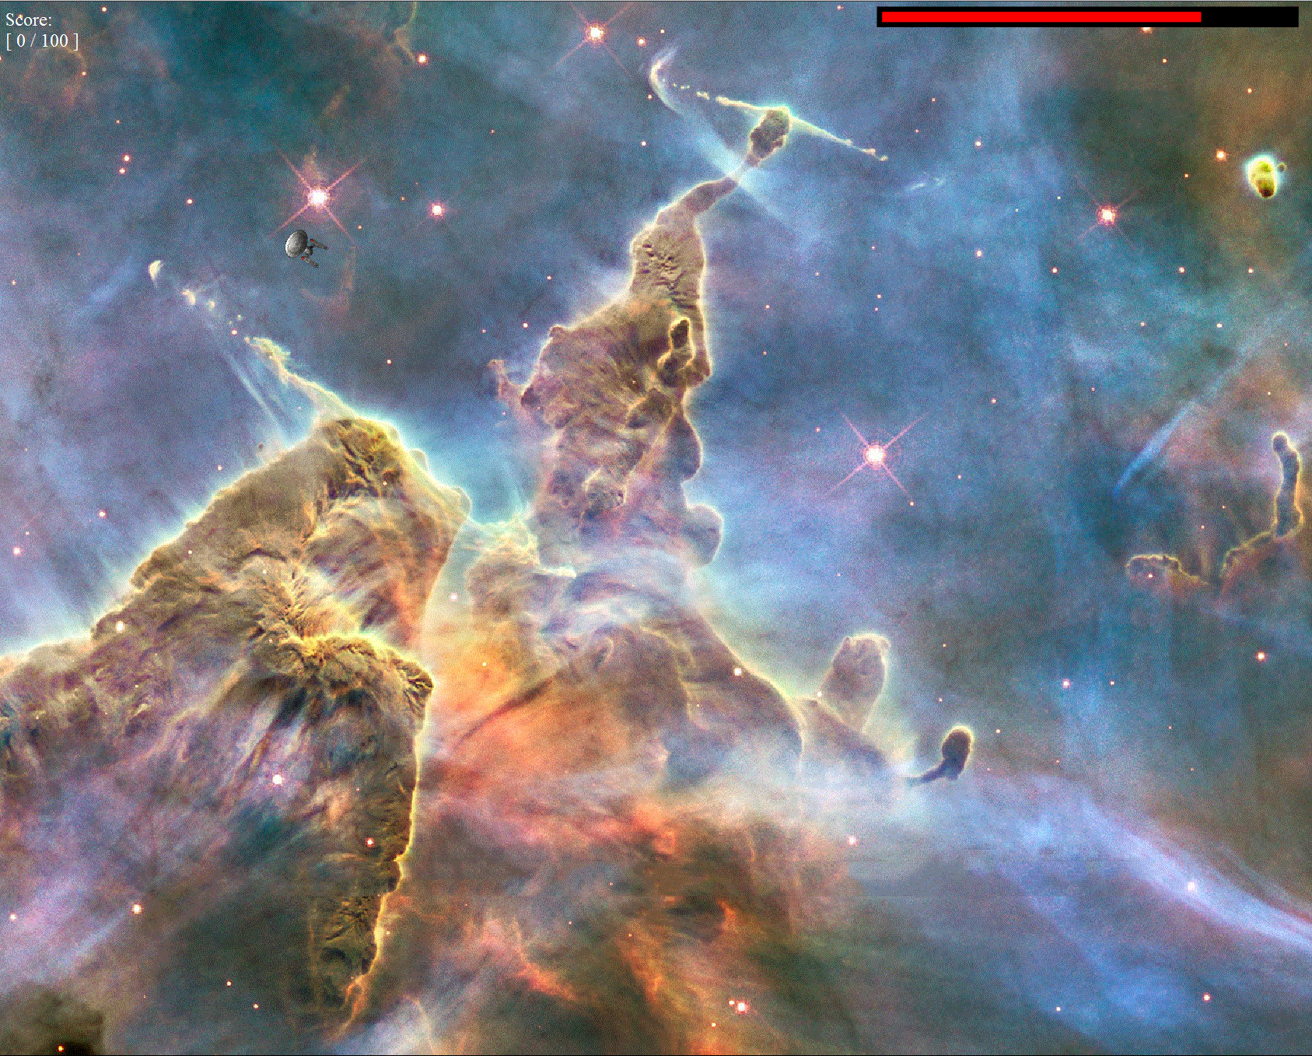
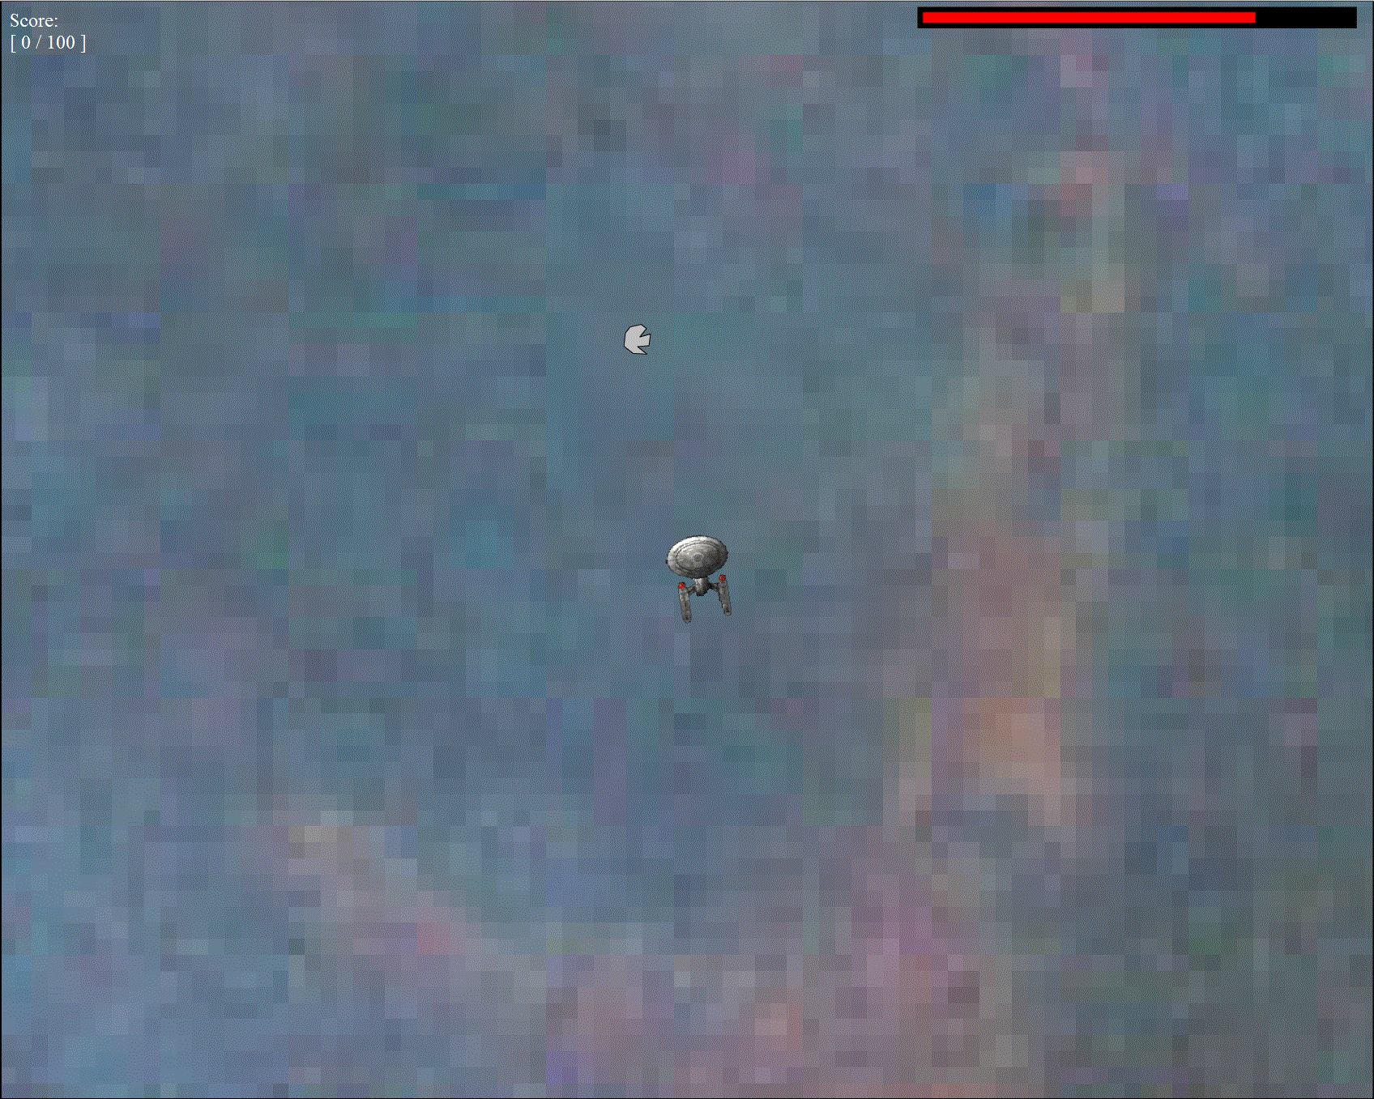
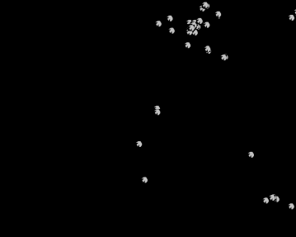
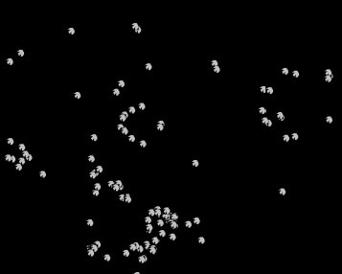
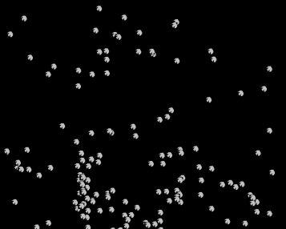
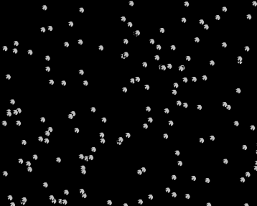
Adaptive Foraging:
Effects of Resource Conditions on Search Paths in a Web-Based Foraging Game
Bryan Elvis Kerster, Christopher T. Kello, Theo Rhodes, Ralph Jerry Bien-Aime
Cognitive Mechanics Laboratory, University of California, Merced
Introduction
Results
Perhaps the most ancient kind of search function in biological organisms, in terms of evolutionary history, is foraging. Studies of animal foraging have found a common statistical pattern in foraging paths known as a Lévy walk (Viswanathan et al., 1996). Paths are clustered such that most path segments are relatively short, but interspersed with longer segments, occasionally much longer. Intriguingly, the distribution of path lengths consistently follows an inverse power law,
P(l) ~ 1/l^{α}
where α ~ 2. Lévy -like path lengths are observed for foragers from bacteria (Berg, 1993) to humans (Rhee, Shin, Hong, Lee, & Kim, 2011).
A total of 1,825 play sessions were administered on Turk. Participants who did not produce more than 80 zoom in actions per play were excluded from analysis (603 participants).
We examined whether foraging paths resembled Lévy walks, in the sense that path length distributions were power law distributed with estimated exponents near two. We used multi-model inference (Symonds & Moussalli, 2010) to test which of four different functions provided the best fit to the distribution of path lengths for each participant (a mean of 217.4 path segments per participant): Normal, exponential, lognormal, and Pareto. Only the latter two are heavy-tailed and Lévy-like, and the method uses Akaike’s information criterion (AIC) to find the function with the shortest information-theoretic distance to the data. The lognormal function provided the best fit for 68% of the participants, with the remaining trials roughly evenly split between normal and exponential fits.
All results are graphed and analyzed as a function of sparsity, clustering, and performance category. A three-way analysis of variance was conducted for each dependent measure
Example Foraging Movements
Example Distribution
Example Levy Flight
Cognitive scientists have begun to investigate whether they occur in perceptual, memory, and decision-making search tasks. Rhodes and Turvey (2007), investigated Lévy walks in a classic category recall paradigm (Bousfield & Sedgewick, 1944). Participants recalled as many animals as they could from long-term memory, for twenty minutes. Inter-response intervals were used as indirect measures of memory “path lengths”, and they were found to be best fit by inverse power law functions with exponents near two. Rhodes, Kello, and Kerster (2011) found that saccade lengths in visual foraging tasks also followed a heavy-tailed distribution resembling the optimal Lévy walk.
These studies raise the question of what mechanisms and factors give rise to Lévy-like search paths across so many different species and foraging conditions. Theoretical analyses suggest that sparsity of targets is a factor, but it is prohibitively difficult to test this hypothesis in natural foraging conditions. Also, most theoretical analyses have assumed randomly distributed targets (Viswanathan & Buldyrev, 1999), but food and other resources may instead tend to be clustered in nature.
In the present experiment, we examined the roles of sparsity and clustering in a web-based video game designed to mimic canonical foraging. We used a video game because it allowed us to know and manipulate search conditions. We made the game web-based so that we could collect data from very large numbers of participants on Amazon’s Mechanical Turk.
Performance
Path Lengths
Lognormal σ
Regression Slopes
Methods
The foraging game was framed as a task of exploring outer space to find resources on asteroids. (To play, go to http://cogmech.ucmerced.edu/downloads.html). Participants used a mouse (or functionally equivalent device) to move a spaceship over a 1280x1024 grid of space. Movement was controlled at two scales, zoomed in and zoomed out. When zoomed out, the entire space was visible at once, and participants clicked on a location to “fly” the ship to that spot (shown by animation). Participants pressed the space bar to zoom in 15X at a given location, at which point they again could navigate the ship via point-and-click
Conclusions
The search patterns of human foragers in a virtual task remain generally consistent with those of foraging animals in their overall distributional properties. Participants demonstrated Levy-like distributions of their movement path lengths, similar to distributions found in foraging animals, and some cognitive search tasks.
One important feature of the search strategies utilized by foragers in this task are the clear uses of memory that can be seen in the directional patterns of movement. Much prior modeling of foragers have focused on memory-less foraging where the forager moves in a random direction.
The number of asteroids per play was set at four different levels: 25, 50, 100, and 150. Pilot work indicated that 25 asteroids meant that players occasionally found only a few of them (or even none), and 150 meant that players found asteroids nearly every time the zoomed in. Clustering of asteroids was manipulated at four different levels of a probabilistic parameter: 0.05, 0.15, 0.25, and 0.5. This parameter controlled the probability of dividing asteroids evenly (0.5) or entirely to one side (0.0) in an algorithm that divided a given set of asteroids recursively into alternating horizontal and vertical splits of a given 2D space.
Acknowledgements
This work was supported by a grant from the National Science Foundation, BCS 1031903 (PI Kello).
References
Berg, H. C. (1993). Random walks in biology. Princeton University Press.
Bousfield, W. A., & Sedgewick, C. H. W. (1944). An analysis of sequences of restricted associative responses. Journal of General Psychology.
Rhee, I., Shin, M., Hong, S., Lee, K., & Kim, S. (2011). On the levy-walk nature of human mobility. /ACM Transactions on, 19(3), 630–643.
Rhodes, T, & Turvey, M. (2007). Human memory retrieval as Lévy foraging. Physica A: Statistical Mechanics and its Applications, 385(1), 255–260. doi:10.1016/j.physa.2007.07.001
Rhodes, Theo, Kello, C. T., & Kerster, B. (2011). Distributional and Temporal Properties of Eye Movement Trajectories in Scene Perception. The Annual Meeting of the Cognitive Science Society.
Viswanathan, G., Afanasyev, V., Buldyrev, S., Murphy, E., Prince, P., & Stanley, H. E. (1996). Lévy flight search patterns of wandering albatrosses. Nature, 381(6581), 413–415.
Viswanathan, G., & Buldyrev, S. V. (1999). Optimizing the success of random searches. Nature, 401(6756), 911.
The 4 Clustering Conditions

